Slide 1
GSU Honors Program
Welcome
High School Counselor Luncheon 2022
Craig Berry
Associate Director of Admissions
cberry@govst.edu

Slide 2
Today’s Agenda
Today’s Agenda
Introduction of the GSU Admissions Team and Guests
Para to Professional Teacher Pipeline
Trio
GPAth Pathways to Graduate Programs
Honors Program
Admissions Updates
Questions and Answers

Slide 3
Para to Professional Teacher Pipeline
Dr David Conrad

Slide 4
Overview
Partnership Pathway to Teaching is a community based grow-your-own teacher initiative to address teacher shortages, retention issues, and teacher diversity by engaging in a variety of strategies that aim to recruit teachers from local schools in hopes that the pool of candidates will increase in diversity and will be more likely to stay teaching in the community.
Goals:
Meet the teacher demands (shortage) of local rural and south suburban districts
Create a continuous pipe-line to teaching
Design as low cost to the IHE, LEA, and Candidate
Build retention by supporting candidates and new teachers through quality mentorship
Increase teacher diversity
Flexible delivery to meet the needs of working candidates i.e., evenings, weekend, hybrid.

Slide 5
Student Pathway
High School
Identify future teacher
Preparation for Para test
Para Pro
Para Professional Exam
Employment as a para-professional
Teacher Candidate
Select Teacher Preparation Program (7 content areas)
Cooperating Teacher = Long-term Mentor
Embed teaching activities
Job-embedded field experiences and student teaching
Earn B.A. in Content Area
Licensure in Content Area
Enroll in teacher preparation program

Slide 6
Para-Pro B.A. Pathway
Para Pro
Para Professional Exam
Employment as a para-professional
Teacher Candidate
Select Teacher Preparation Program (7 content areas)
Cooperating Teacher = Long-term Mentor
Job-embedded field experiences and student teaching
Earn B.A. in Content Area
Licensure in Content Area
Enroll in teacher preparation program

Slide 7
Para-Pro M.A. Pathway
Para Pro
Para Professional Exam
Employment as a para-professional
Teacher Candidate
Select Teacher Preparation Program (7 content areas)
Cooperating Teacher = Long-term Mentor
Job-embedded field experiences and student teaching
Earn B.A. in Content Area
Licensure in Content Area
Enroll in teacher preparation program

Slide 8
Para-Pro B.A. Pathway
Para Pro
Para Professional Exam
Employment as a para-professional
Teacher Candidate
Select Teacher Preparation Program (7 content areas)
Cooperating Teacher = Long-term Mentor
Job-embedded field experiences and student teaching
Earn B.A. in Content Area
Licensure in Content Area
Enroll in teacher preparation program

Slide 9
GSU Participating Programs
Bachelor Initial Licensure Programs | Master Initial Licensure Programs
Early Childhood w ESL endorsement w EC SPED approval Elementary B.A. Secondary Biology Chemistry English Mathematics Social Studies | Early Childhood W SPED Approval Special Education LBSI Secondary Biology (pending approval) English (pending approval) Mathematics

Slide 10
Curriculum
Job-embedded field experiences
Job-embedded student teaching
Flexible scheduling
Evening
Weekends
Hybrid
Online

Slide 11
GSU Scholarship Dinner
Wednesday November 30, 2022
5:30-7:00 PM
Students learn about our most prestigious scholarships
Presidential
Provost
Dean’s

Slide 12
GSU Scholarship Dinner
Wednesday November 30, 2022
5:30-7:00 PM
Students learn about our most prestigious scholarships
Presidential
Provost
Dean’s

Slide 13
High Honors Scholarships
Presidential
4 years tuition and fees
Free student housing at Prairie Place
$8,000 ($1,000/semester) in meal money
$4,000 ($500/semester) in book vouchers at the GSU Bookstore
Provost
$32,000 ($8,000/year)
Dean’s
$28,000 ($7,000/year)
Can be stacked with other scholarship/grant money!

Slide 14
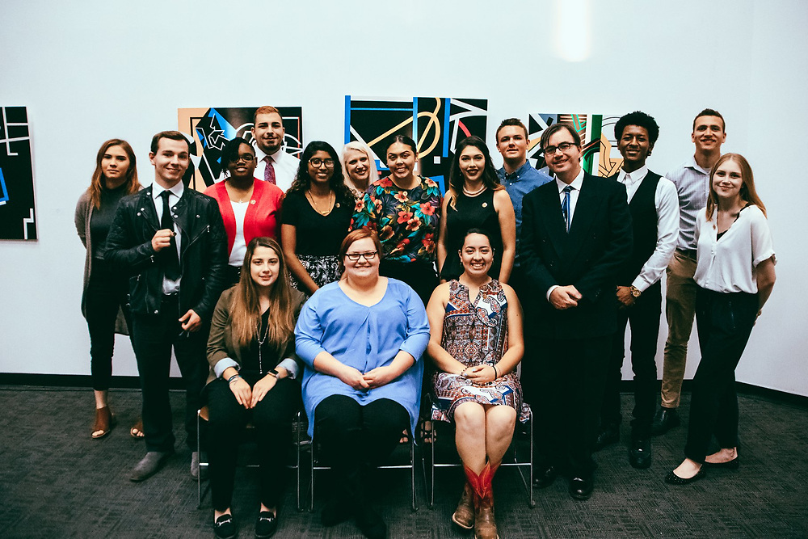
What is different about
University Honors?
It is not about doing more work than non-Honors courses
Innovation
Leadership
Creating Initiatives
Community Building

Slide 15
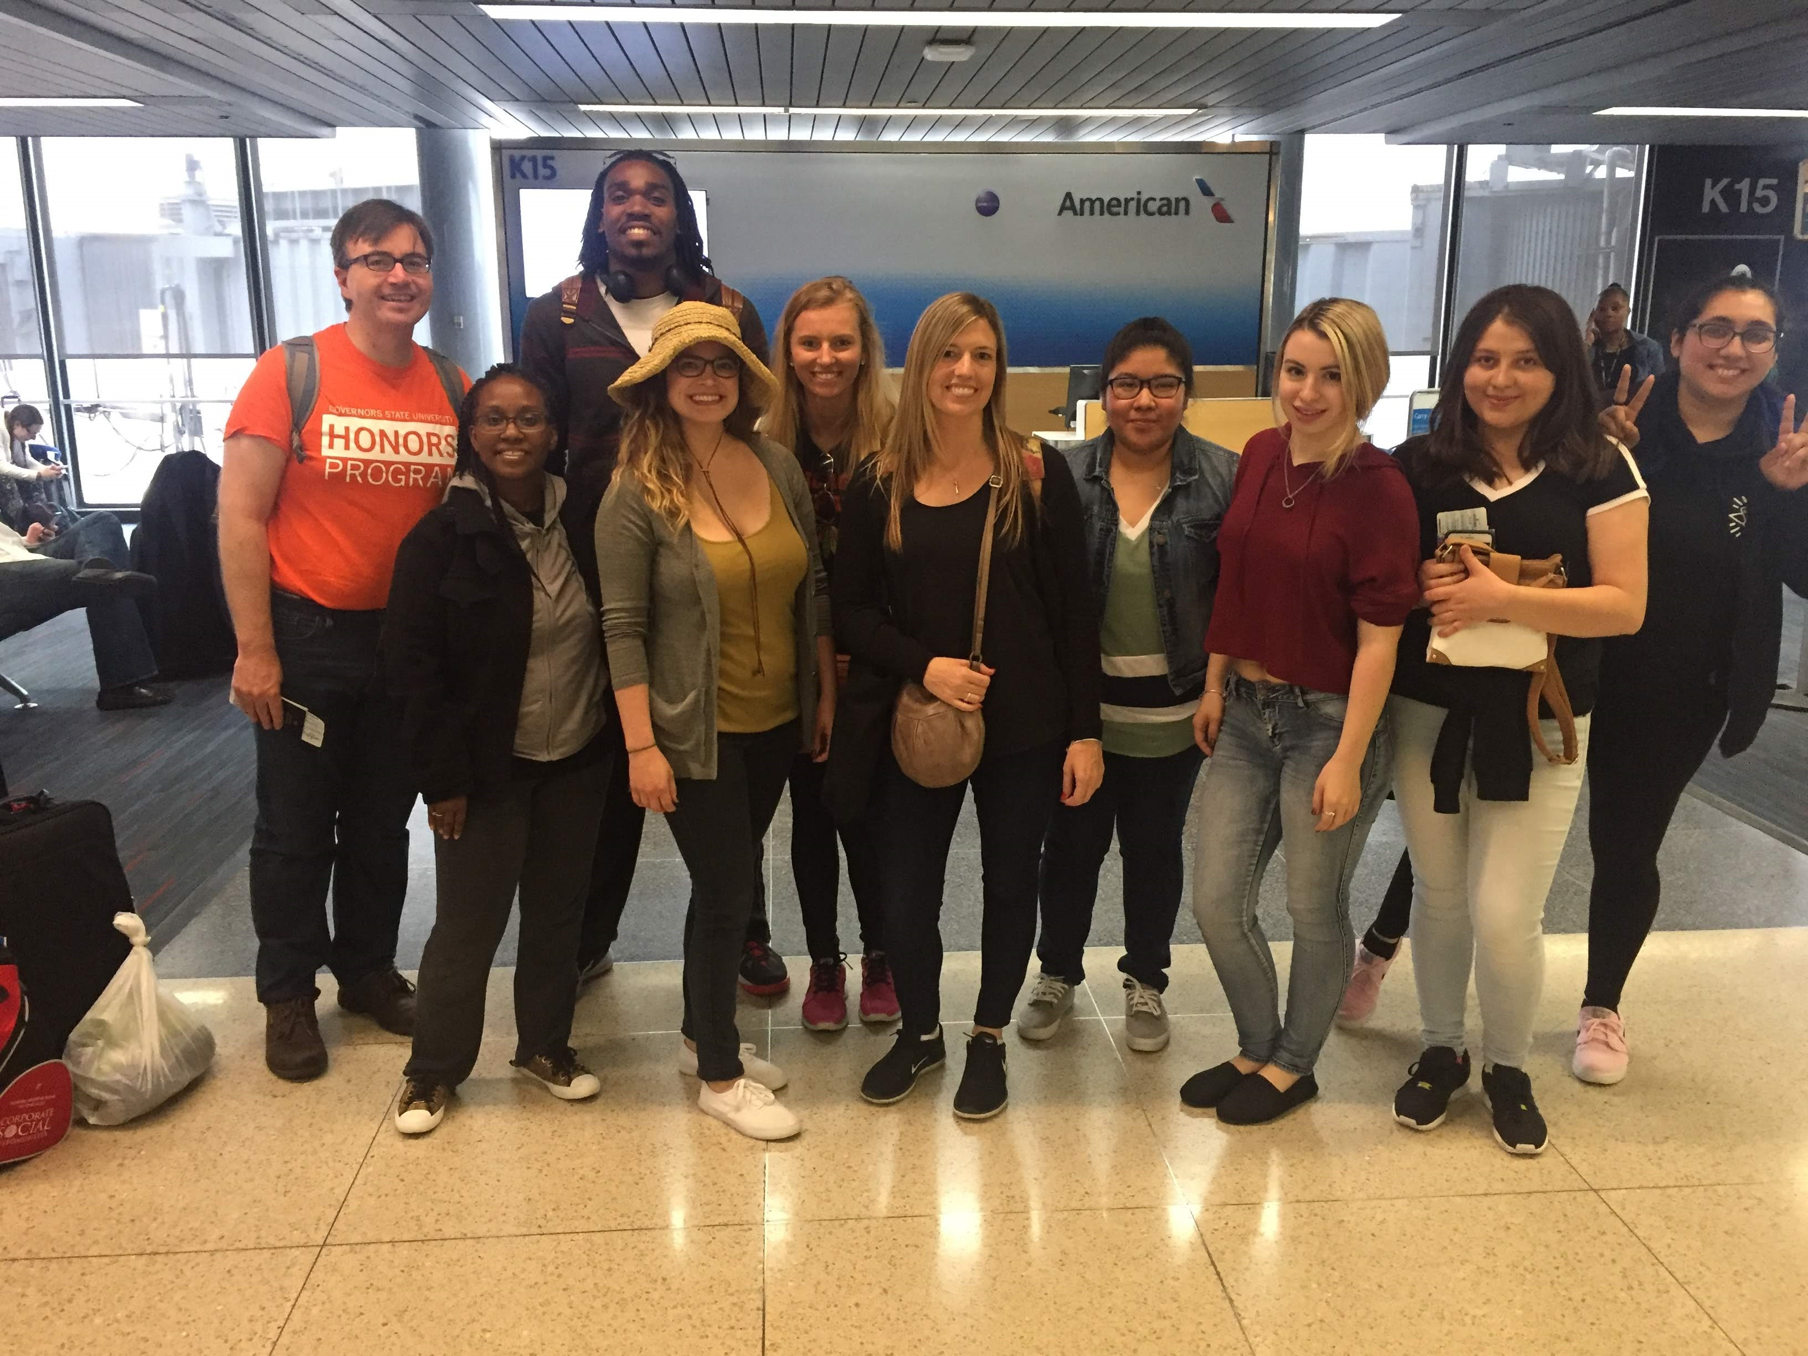
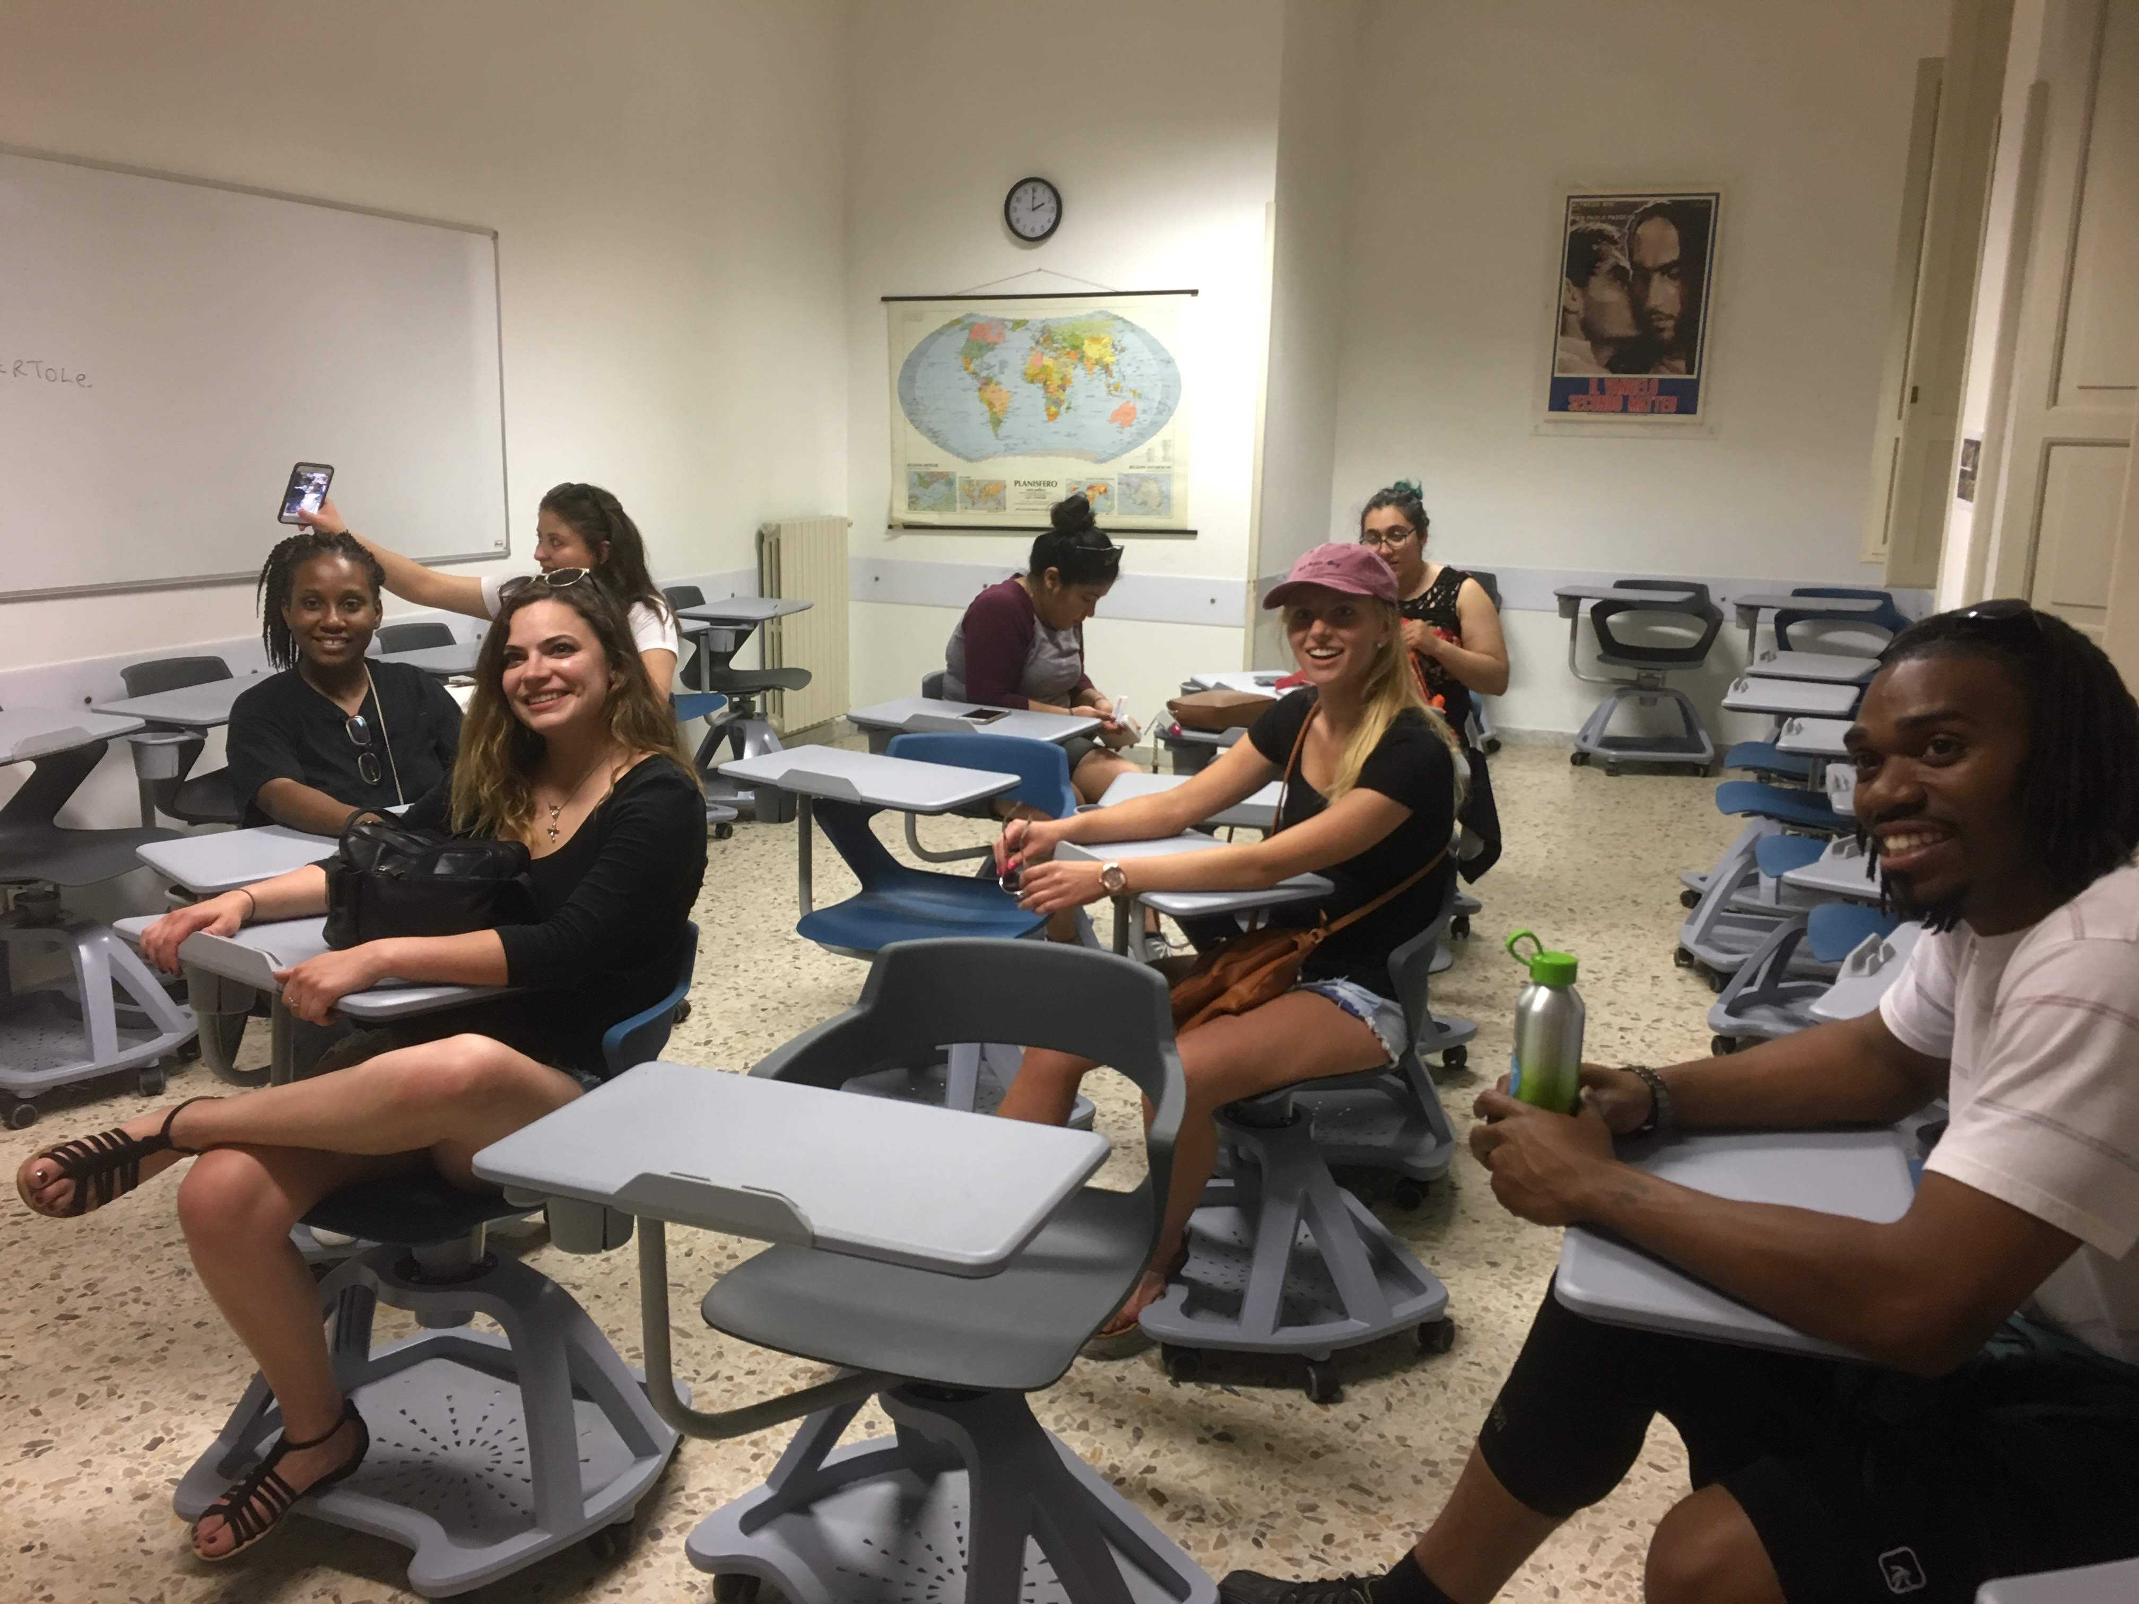
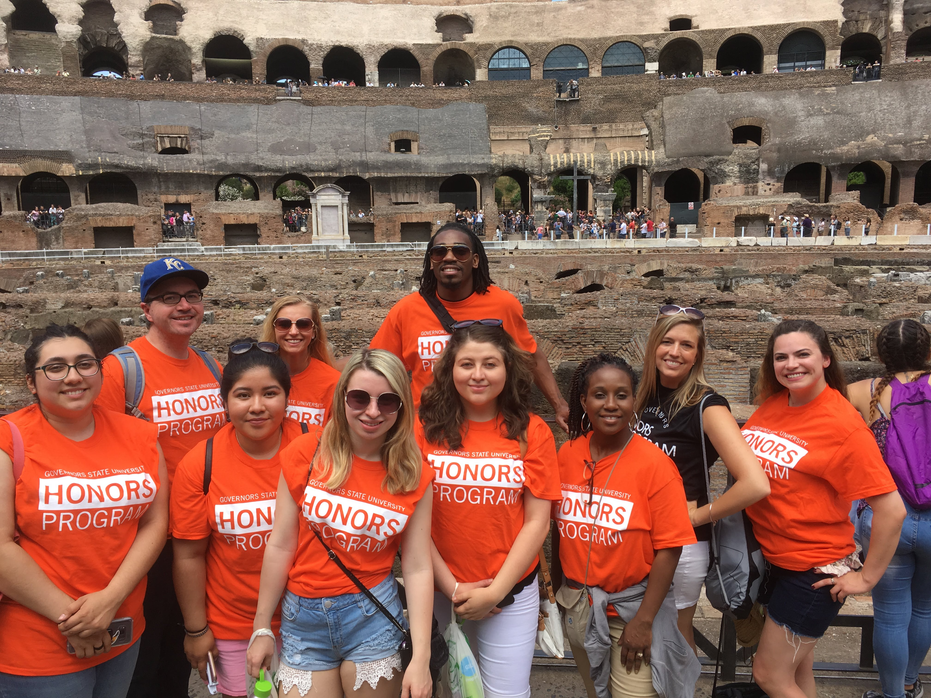
Honors Study Abroad in Rome, Italy

Slide 16
Applying for Honors is Easy!
The student’s GSU application is also their GSU Honors Application
Dr. David Rhea, the Honors Program Director, evaluates each applicant for Honors
We notify the student if they are eligible
The student then informs us of their interest in the program

Slide 17
GSU Honors Student Panel

